Slide 1

Basic Details of the Team and Problem Statement
Organization Name: Department of School Education & Literacy (DoSEL), Ministry of Education
PS Code: RK783 Problem Statement Title: Crowd sourcing model for preparing large question banks Team Name: PSUDO CODERS
Team Leader Name: Luckshya Verma Institute Code (AISHE): U-0172 Institute Name: NIT Kurukshetra
Theme Name: Miscellaneous

Slide 2
Idea/Approach Details
Solution :
Question Paper setting has been a combustive task due to repetition of questions, subjective difficulty level, etc.
This has been countered by our Crowd Sourcing model as we accept the questions from different users.
These questions are then subjected to a thorough review process by experts, then, are added to the bank and hence ready to be put in any question set which are categorized on the basis of topics and subjects as per the need.
Now, the setter just need to enter the number of questions in a paper and there will be a question set which matches all the requirements of the setter without any redundancy.
Technology stack used:
MERN stack has been used in our solution to the crowd sourcing problem.
Using MERN stack, we were able exploit:
The speed of Express.js in handling HTTP request.
React.js ’s ability of data driven interface with minimal code
MongoDB’s ability to process and store the JSON documents created in React.js

Slide 3
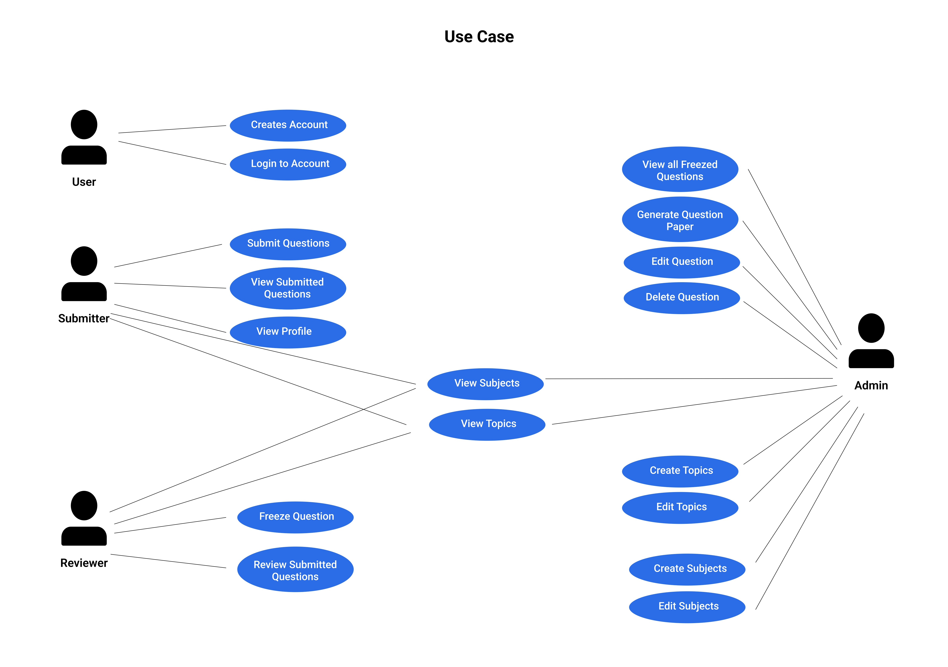

Slide 4
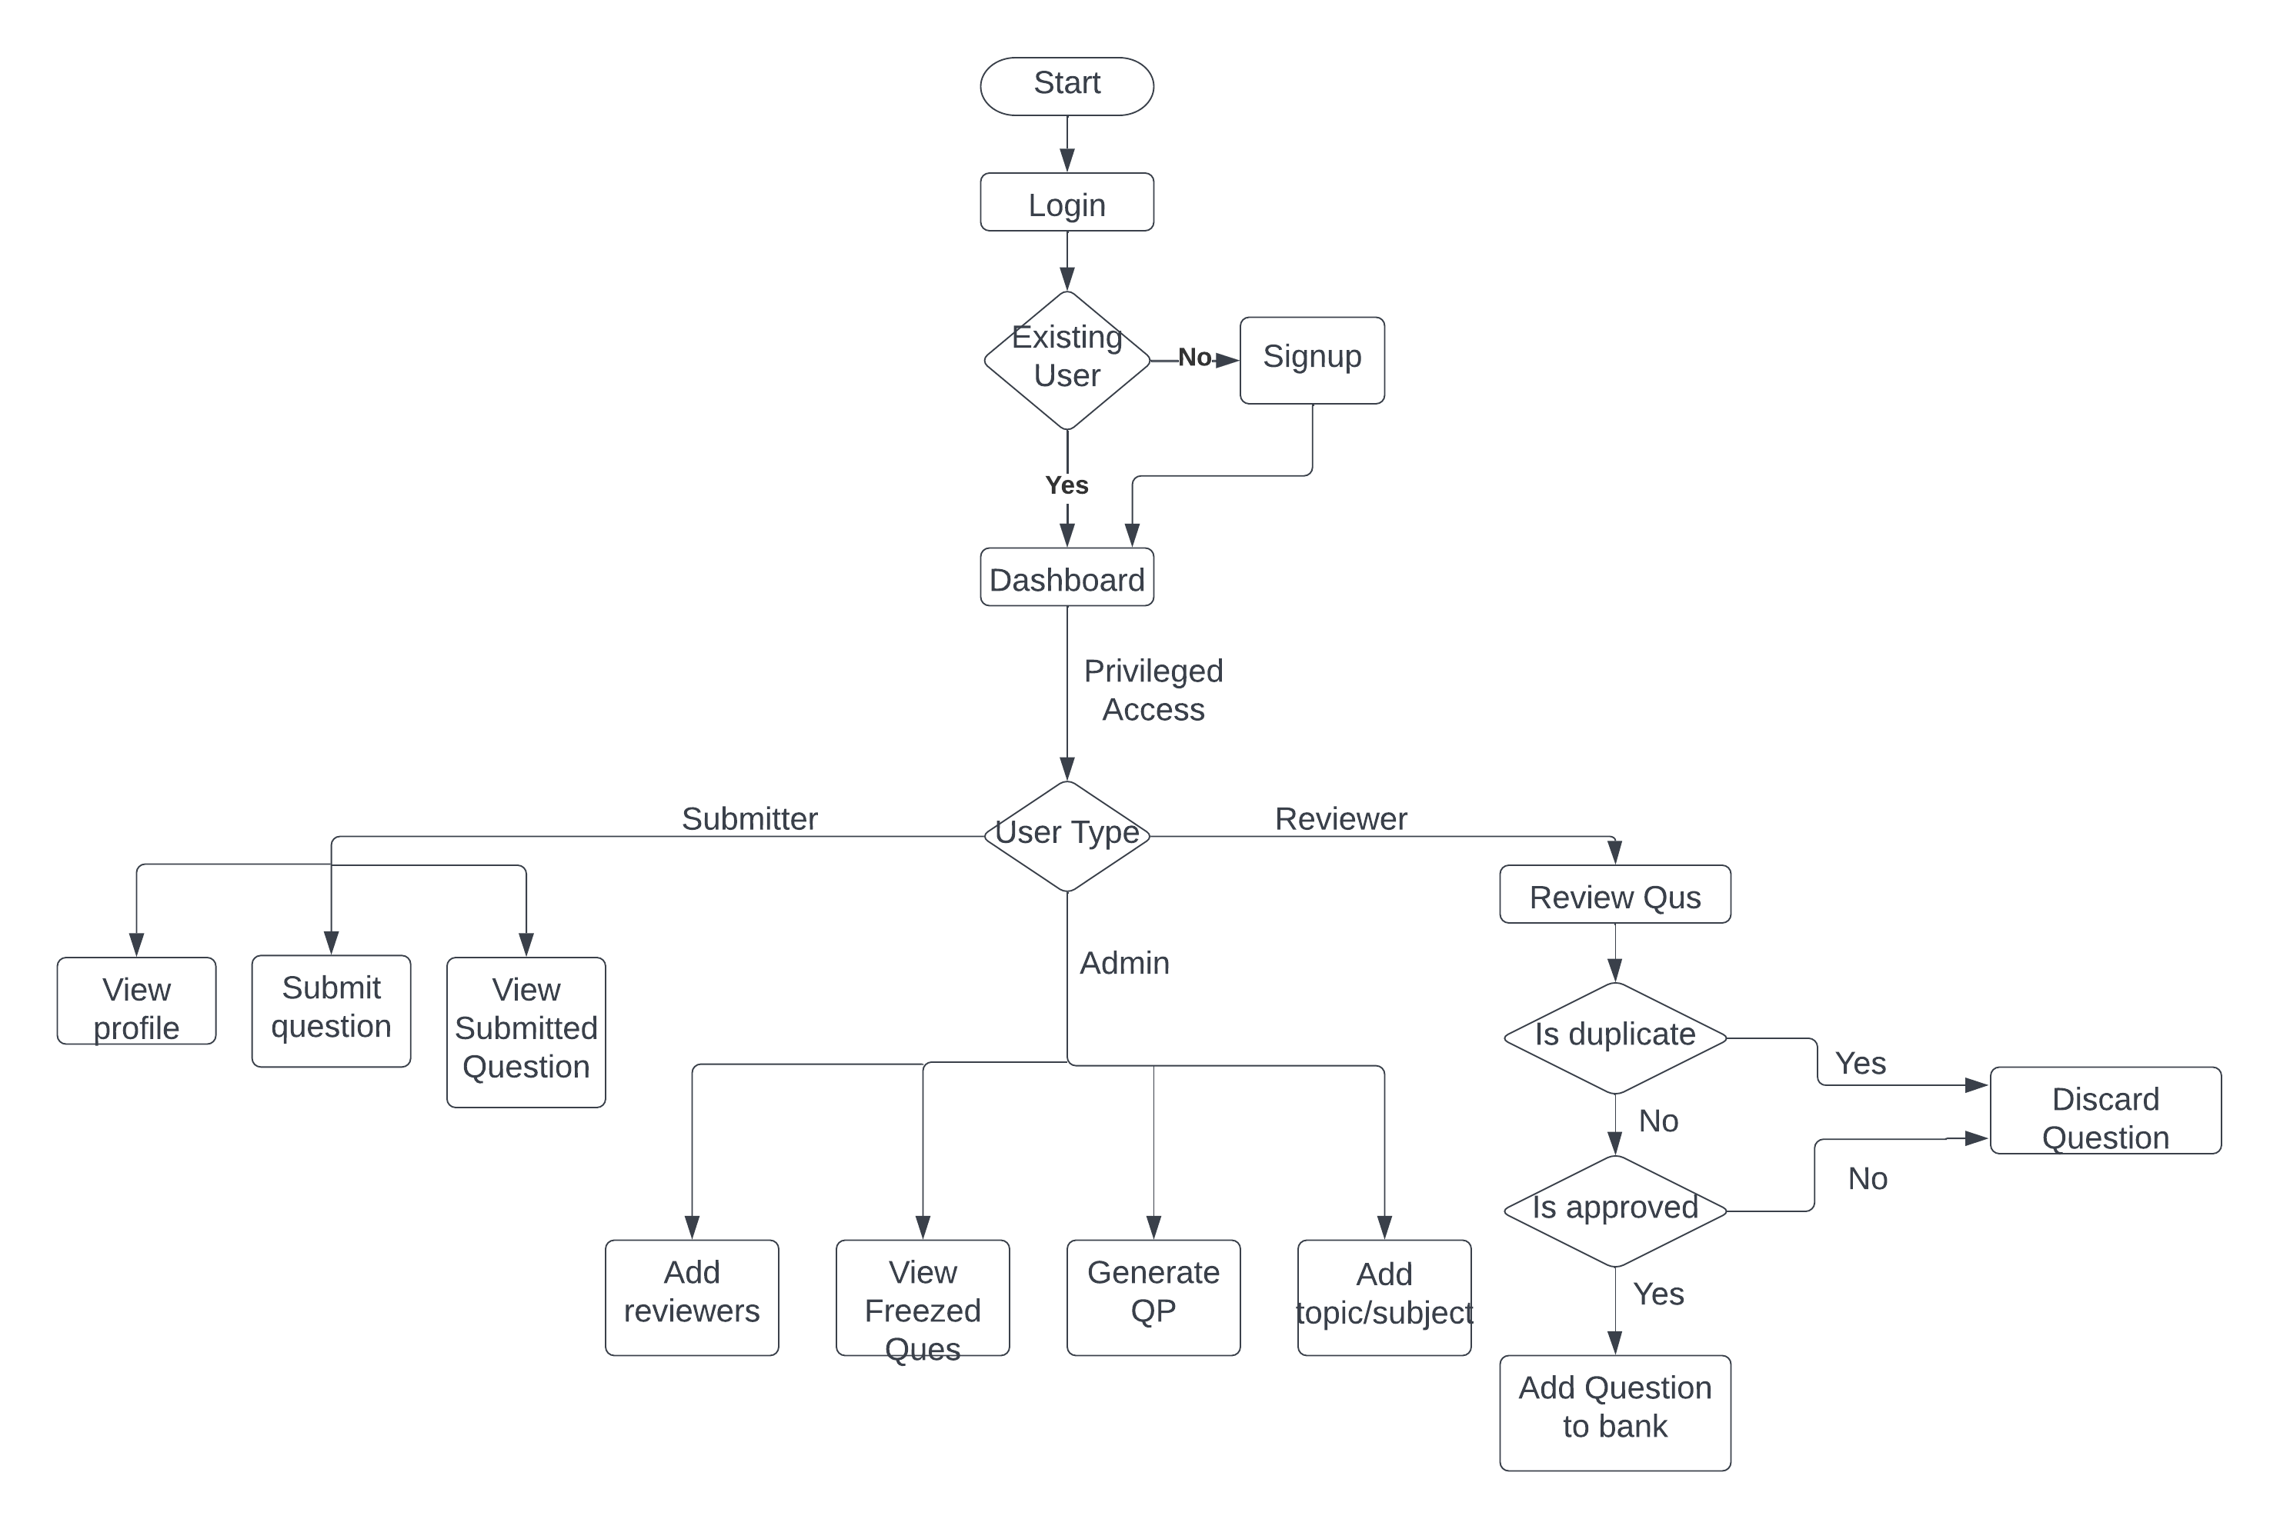

Slide 5
Idea/Approach Details
Describe your Use Cases here
Describe your Dependencies / Show stopper here
Reviewer : Reviews the questions manually
(Log in, Checks the question, Approve / Reject the question)
Submitter : Submits the questions on the portal (Logs in, Submit the question, Get notified about status of submitted question)
Admin : Has administrator access over QUBA (Generate the question set, Review questions, Submit questions, Delete invalid questions, Create topic/ subjects, Add new reviewers)
React-Query is the main dependency of our solution. It has helped us to reduce extravagant efforts on integrating our codebase and passing data from backend to frontend.
The show stopper for our solution is the attachment of images in questions as well as answers. The hosting and displaying of images is a real issue as we need the images in higher quality and in a smaller size.
The evaluation of quality of images posed an issue.
Notes:
How can the show stoppers be removed?
Quality of images can be completed by LaTeX.
The hosting of images can be done at imgur.

Slide 6
Team Member Details
Team Leader Name: Luckshya Verma
Branch : B.Tech Stream: CSE Year : II
Team Member 1 Name: Lovesh Verma
Branch : B.Tech Stream: IT Year : II
Team Member 2 Name: Manmeet Singh
Branch : B.Tech Stream: CSE Year : II
Team Member 3 Name: Rahul Shrimali
Branch : B.Tech Stream: CSE Year : II
Team Member 4 Name: Ritesh Gupta
Branch : B.Tech Stream: CSE Year : II
Team Member 5 Name: Namya Kohli
Branch : B.Tech Stream: CSE Year : II
Team Mentor 1 Name: Type Your Name Here
Category (Academic/Industry): Expertise (AI/ML/Blockchain etc): Domain Experience (in years):
Team Mentor 2 Name: Type Your Name Here
Category (Academic/Industry): Expertise (AI/ML/Blockchain etc): Domain Experience (in years):

